Slide 1
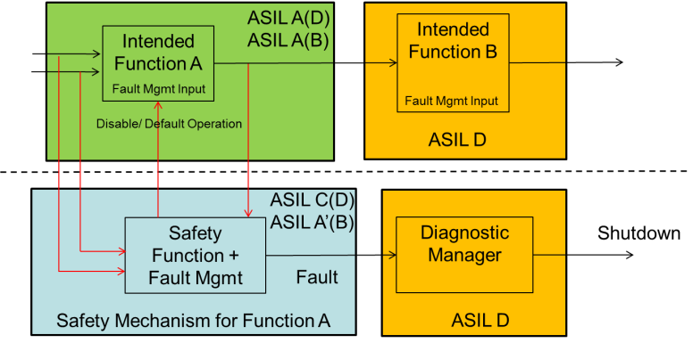
SE14 – Next Generation Systematic Software Error protection
Description
Desire an ASIL Decomposition strategy that is not vehicle calibration intensive which satisfies all customers and fits within available resources
Motivation (Type:x)
Expected by German OEMs
Original BMW UKL design required much in-vehicle iteration for calibration
Deliverables
Safety functions to provide systematic protection for functions between input reads and motor control
Analytical calibration strategy
Timing
Scheduled to begin mid-2015, targeting EA4.x applications
Team Members/Customers
Scott Millsap / IBK, EA4.x applications

Slide 2
SE14 – Next Generation Systematic Software Error protection
Status
ASIL C(D) / ASIL A(D) decomposition strategy developed utilizing a safety mechanism combined with an intended function
Does not appear to increase memory and throughput burden over UKL
Input reads have systematic protection concepts but need detailed design
Safety functions for the EPS command functions need to be designed
Calibration strategy needs to be defined
Challenges
Resources: PSA deliverables have priority
Next Steps
Prepare schedule of design activity, following “left to right” pattern

